Slide 1
The Tragedy of Flight: A Comprehensive crash analysis
By
N.Meharaj
A.Mahalakshmi
K.Kothainayagi
P.Menaga

Slide 2
Intoduction
Project Description
An airplane crash analysis is a detailed investigation into the causes of an aviation accident. The goal of an airplane crash analysis is to identify any factors that contributed to the accident, with the ultimate goal of improving safety and preventing future accidents.
The process of conducting an airplane crash analysis typically involves the collection and analysis of a wide range of data, including information about the aircraft and its systems, the operators, and any other relevant factors.
This data is typically collected from Kaggle. Once the data has been collected, it is analysed through tableau, to identify any potential causes of the accident.
The results of an airplane crash analysis are typically published in a report, which may include recommendations for improving safety and preventing similar accidents in the future.
These recommendations may be implemented by the relevant authorities or industry organizations.

Slide 3
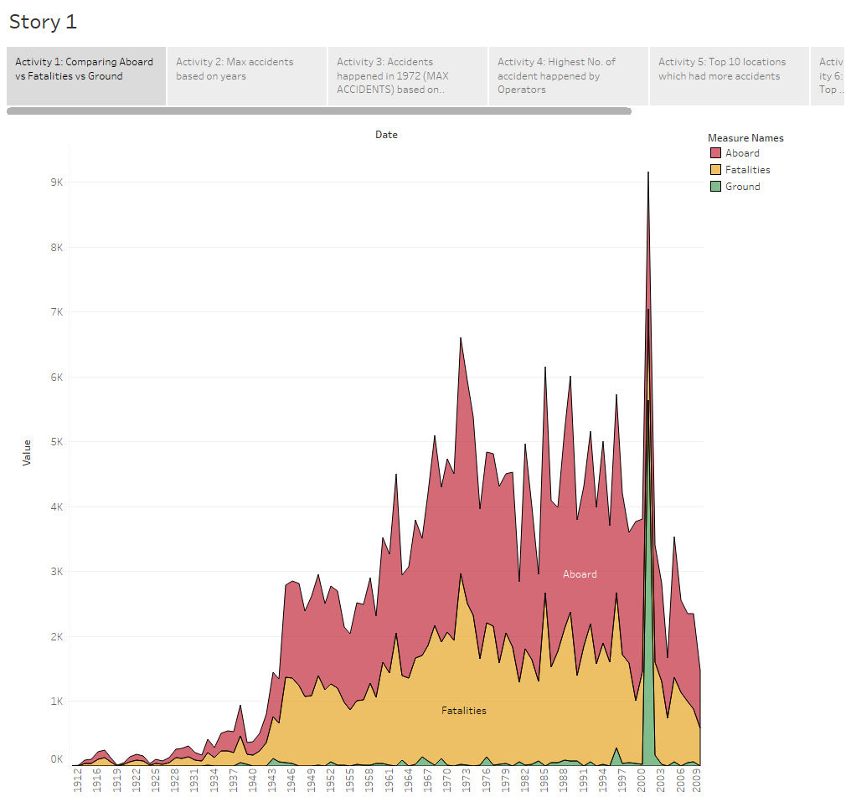
Comparing Aboard vs Fatalities vs Ground

Slide 4
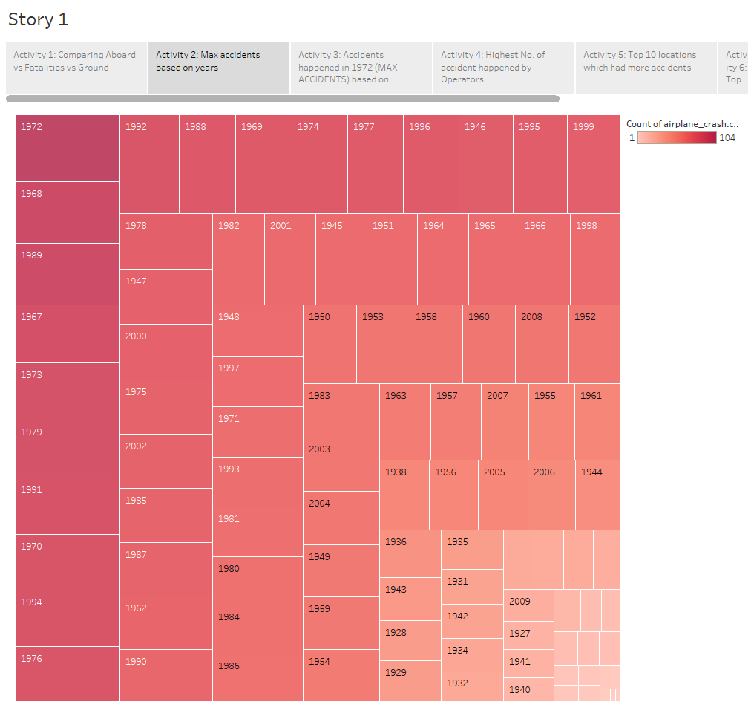
Max accidents based on years

Slide 5
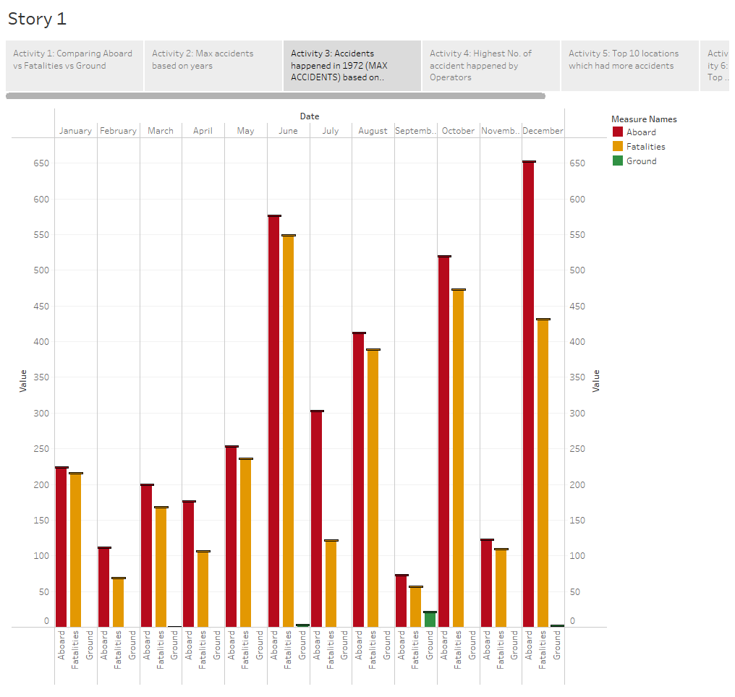
Accidentshappened in 1972 (MAX ACCIDENTS) based on months

Slide 6
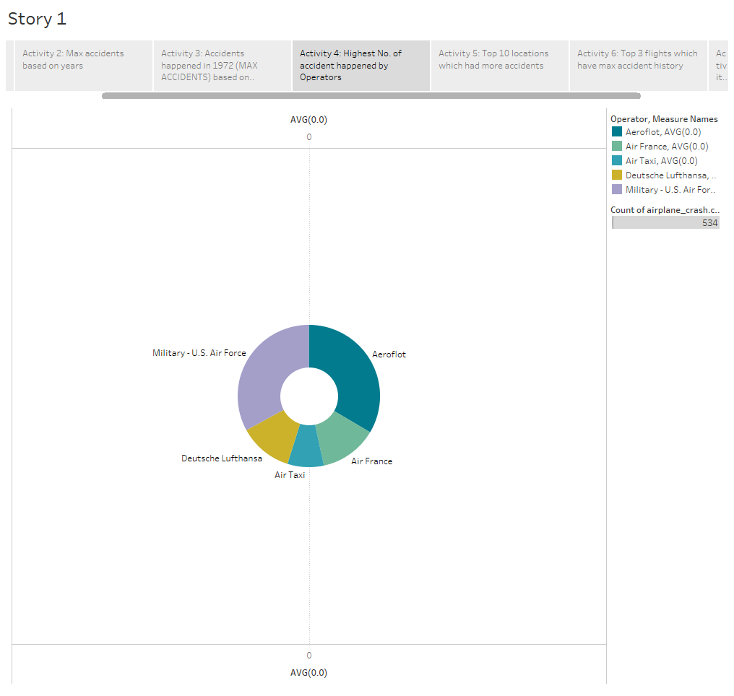
Highest No. of accidenthappened by Operators

Slide 7
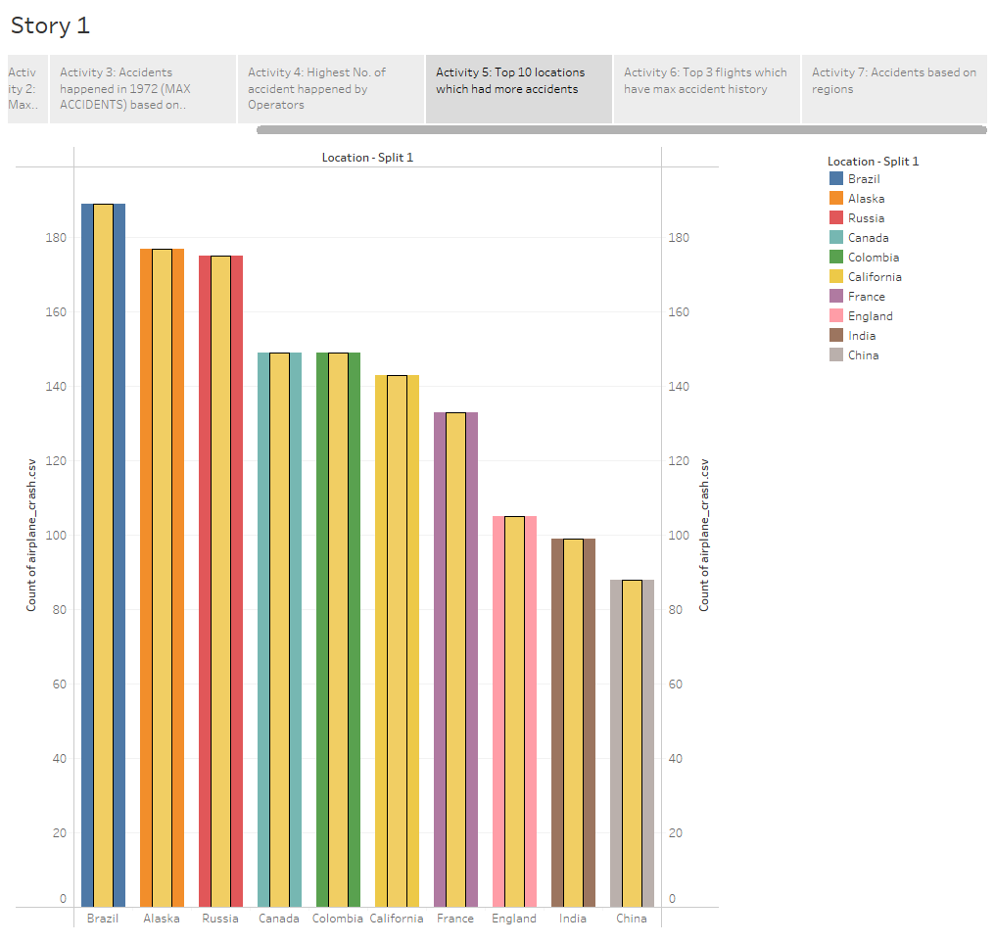
Top 10 locationswhichhad more accidents

Slide 8
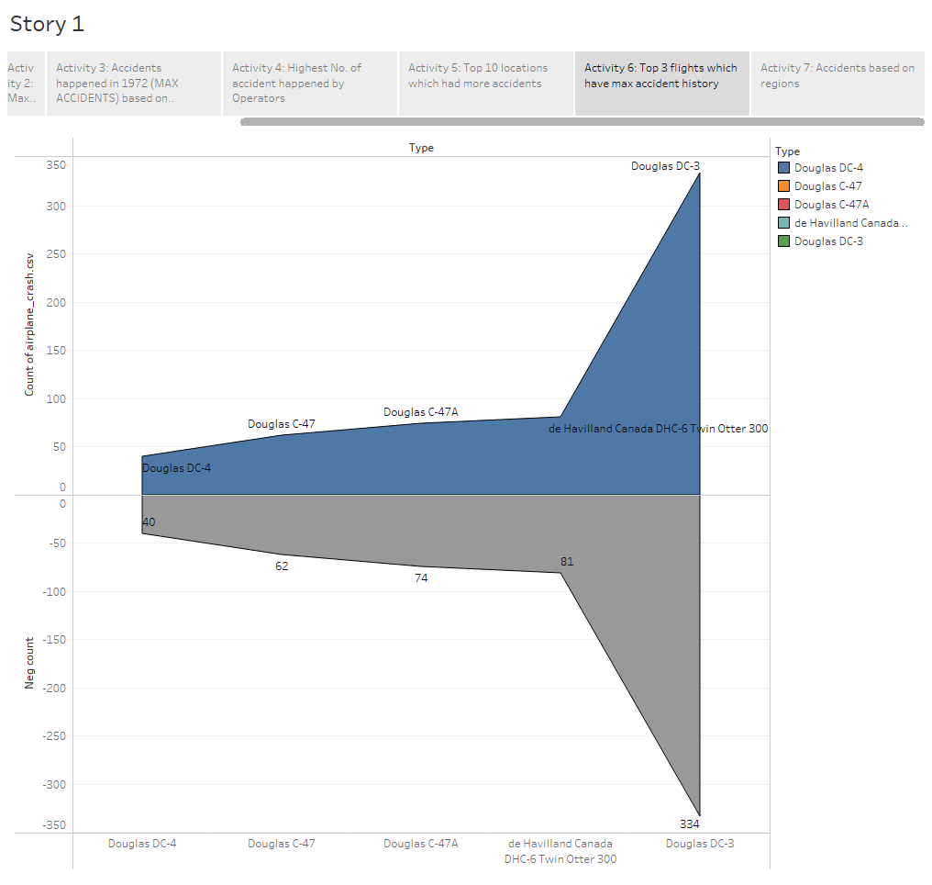
Top 3 flightswhichhave max accidenthistory

Slide 9
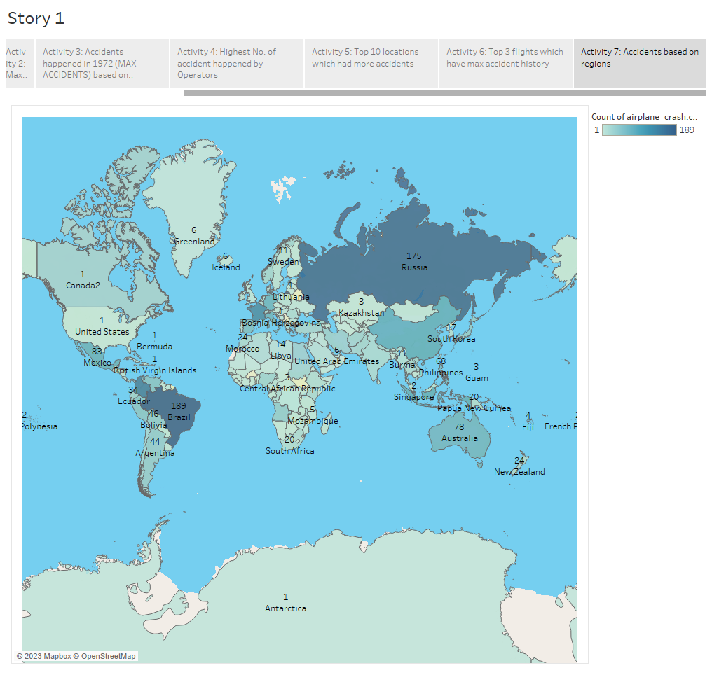
Accidentsbased on regions

